Slide 1
Group Project Group 18
Ionut Ciobanu
Bailey Keeble
Jack Fuller

Slide 2
Logline
Beat your opponent by destroying the blocks beneath you to get to the bottom of the screen before them.
2 Player
Mobile Game
Turn based block destroyed

Slide 3
What does the player do?
Both players must destroy all of the blocks underneath them to get their character to the bottom of the screen.
Various blocks have different properties such as stone blocks, fire blocks and water blocks.
If a player destroys a stone block between a fire and water block, then the water block will also destroy the fire block without the player tapping it.

Slide 4
Mechanics
A Few of the mechanics that will be involved in the game will be :-
Tapping the blocks
Destroying the blocks
The combo, or order of blocks being tapped.
E.g. tapping the ice block above a lava block too remove two blocks in one tap.

Slide 5
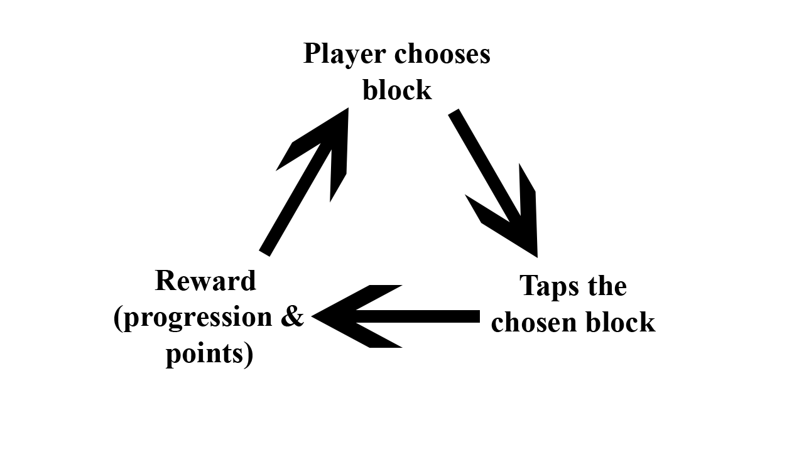
Core Game Loop

Slide 6
What are the games challenges?
The challenge of the game is constituted by choosing to destroy the correct sequence of blocks in order to stay ahead of your opponent by distancing yourself and gaining a higher score.

Slide 7
Target audience
Age:
15 – 30
Gender:
Both males and females
Casual gamers

Slide 8
Questions?

